Slide 1
The relationship between obesity and employment outcomes
Genevieve David with Andy Dickerson and Petra Meier

Slide 2
Background
Substantial evidence that obese women are less likely to be employed
U-shaped relationship between BMI and unemployment, but may be gender-specific
(+) unemployment and obesity among women,
(+) unemployment and (+) UW among men
BMI affects employment through its effect on health and other factors not as well understood

Slide 3
Aim
To determine difference in patterns of association between obesity and employment outcomes between male and female adults in Understanding Society
Obese females are likely to be unemployed or found in domestic, caring, or other roles
Unemployed males are likely to be UW
Employment outcome is multinomial variable rather than as yes/no binary variable
Notes:
Employment outcome does not only mean being or not being in formal employment but includes other activities people engage in when not formally employed
Other roles where physical appearance is not important, not as productive
We do not expect a (+) or (-) association between obesity and employment in males

Slide 4
Data: Understanding Society
Longitudinal sample of adults 16+ years representing the whole UK population and interviewed within household context
Face-to-face interviews with adults
Nurse health assessment includes biomarkers and objective measures of weight and height

Slide 5
Variables
Measure of obesity: BMI (kg/m²)
Self-reported in wave 1 & nurse-measured in waves 2 and 3
Underweight | <18.5
Normal | 18.5 to <25
Overweight | 25 to < 30
Obese | 30 to <40 (mod. Obese) >=40 (severely obese)
Notes:
Mention the eligibility criteria for nurse health assessment
Completed personal interview in relevant wave
Completed interview in English
Lives in Scotland, England, Wales
Not pregnant

Slide 6
Variables (2)
Wave 1 (self-reported BMI)
Waves 2 and 3 (nurse-measured BMI)
Total observations | No. of BMI observations (%)
50,994 | 44,481 (87)
 | Total obs. | Eligible (%) | No. of obs./ respondents | No. of BMI obs.
Wave 2 | 54,597 | 26,997 (49) | 15,646 | 15,055 (28)
Wave 3 | 49,739 | 8,918 (18) | 5,053 | 4,849 (9.7)
Notes:
Know the difference between unreliable nurse-measured BMI and self-reported BMI –
Cite possible reasons for the large attrition in waves 2 and 3:
Non-eligibility
Not contact, moved/unable to be located
Possible reasons for refusal:
Obese might actually not want their BMI to be measured
Generally, obese or not, people find getting their measurements intrusive
Household refusal – even just one person in the HH refusing can lead to the entire HH members refusing
Hence:
Wave 1: large sample, but inaccurate measurements
Waves 2 and 3: very small sample, but accurate measurements
Either self-reports or small sample size may introduce greater bias
Possible ways to investigate bias
Look at weight and height measurements in waves 2 and 3, compare with wave 1 and look for where the mistakes are; and see whether self-reports differ by any pattern by gender
Compare results of analysis in wave 1 and waves 2 & 3: magnitude and direction of association (not just because people shifted weights in the succeeding wave)

Slide 7
Variables (3)
2. Employment outcomes
In paid employment
Unemployed
On maternity leave/looking after family
Long-term sick sick/disabled
Other (on gov’t training, unpaid worker in family business, working in apprenticeship, self-employed, doing something else)
Notes:
Collapsed categories – assumptions:
On maternity leave + looking after family (assuming they are both are home-based activities involving caring for a family member)
Other (economic activities outside formal paid employment assuming they have the same level of productivity)
Self-employment can be just as intense as being in gov’t training/apprenticeship/family business, or more intense, or less intense

Slide 8
Variables (4)
Covariates:
Gender
Age
Highest educational qualification
General self-reported health
(Average monthly income)
Notes:
Other covariates considered, but not included:
- Smoking and alcohol drinking: measured differently in different ways
income: drastically reduced no. of observations in regression analysis
Educational qualification
Value = 1.0 Label = Degree
Value = 2.0 Label = Other higher
Value = 3.0 Label = A level etc
Value = 4.0 Label = GCSE etc
Value = 5.0 Label = Other qual
General self-reported health
Value = 1.0 Label = excellent
Value = 2.0 Label = very good
Value = 3.0 Label = good
Value = 4.0 Label = fair
Value = 5.0 Label = poor

Slide 9
Proportion of males and females per BMI category
 | Wave 1 (self-reported) |  |  | Waves 2 & 3 (nurse assessment)
BMI | Proportion |  | Total no. | Proportion |  | Total no.
 | Male | Female |  | Male | Female
UW (<18.5) | 33 2 | 67 3 | 1,188 | 37 1 | 63 2 | 282
Normal (18.5 to <25) | 40 40 | 60 49 | 19,839 | 38 27 | 62 35 | 6,276
OW (25 to <30) | 53 41 | 47 30 | 15,517 | 50 43 | 50 33 | 7,476
Obese (>=30) | 44 17 | 55 18 | 7,937 | 42 28 | 58 30 | 5,855
Total | 20,222 | 24,259 | 44,481 | 8,683 | 11,206 | 19,889
 | Pearson chi2(4) = 692.1704 Pr = 0.000 |  |  | Pearson chi2(4) = 329.1498 Pr = 0.000
Notes:
Lesser proportion of normal BMI in waves 2 and 3, greater proportion of OW and obese people (both males and females) in waves 2 and 3 – OW/obese:normal ratio is greater, but same direction as in wave 1
Greater proportion of UW, normal BMI and obese females to males, mixed in OW category
BMI not an accurate measure of adiposity; males can have higher BMI hence, OW due to muscle mass
Magnitude of female underestimation of weight is probably greater than male overestimation of height in wave 1 hence, higher proportion of UW and normal BMI. But the direction is the same in waves 2 and 3.
Large difference in total sample between males and females in waves 2 and 3
Females more conscious of their weight, more likely to agree to be measured (?)
Females more likely to be contacted successfully at the household/respond (?)
Despite this, we see the same direction of differences in proportion
Waves 2 & 3 did not replicate wave 1 (?)

Slide 10
p <0.0001
p = 0.69
Notes:
Odds of being UW and male is lower than in females
Odds of being OW/obese and male is higher than in females
Despite the large difference in total sample between males and females in waves 2 and 3, the direction of the odds is the same, but the magnitude for obesity is greatly reduced in waves 2 and 3. Why?
Female underestimation of their weight is greater than male overestimation of their height in wave 1, but this opportunity to overestimate and underestimate is gone with the nurse assessment

Slide 11
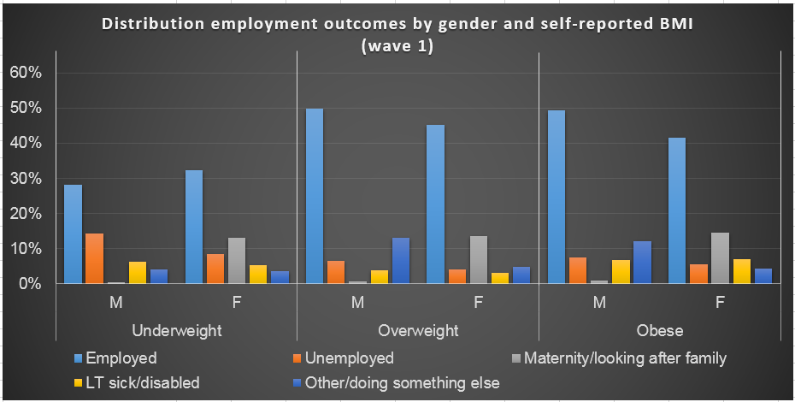
Other: self-employed, on gov’t training, unpaid worker in family business

Slide 12
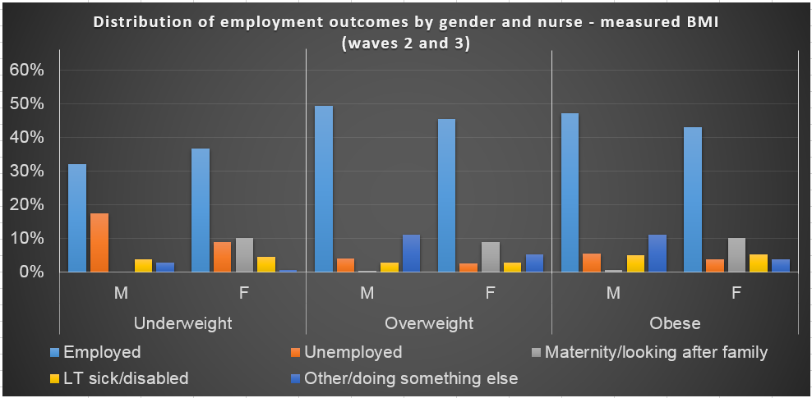
Other: self-employed, on gov’t training, unpaid worker in family business, working in an apprenticeship

Slide 13
Marginal effects from ordered probit regression, wave 1 (self-reported BMI)
UW
OW
Normal
Obese
UW
OW
Normal
Obese
Males
Females
Notes:
Similar PP of being in paid employment for both obese/OW females and males, although PP in females slightly lower. PP is higher when OW>obese. And PP when normal BMI is highest.
The PP of being OW/obese female and unemployed/other is only slightly lower than in OW/obese males; the difference is larger when in home. Normal BMI females have greater PP.
Being UW male has the least PP of being unemployed relative to the other BMI categories.
Similar distribution of employment outcomes between males and females even after adjusting for covariates

Slide 14
Marginal effects from ordered probit regression, waves 2 and 3 (nurse-measured BMI)
UW
OW
Normal
Obese
UW
OW
Normal
Obese
Males
Females
Notes:
Similar PP of being in paid employment for both obese/OW females and males. PP is higher when OW>obese. And PP when normal BMI is lower than obese (males) and OW (females).
The PP of being OW/obese female and unemployed/other is similar to that in OW/obese males; the difference is larger when in home (higher in obese female).
Being UW male has the least PP of being unemployed relative to the other BMI categories.
The distribution of employment outcomes is not as similar. Variations are greater. PP for normal BMI has shifted.

Slide 15
Main findings
Higher proportion of OW+obese adults than normal BMI adults, and obese females than obese males.
Direction of associations did not conform to our hypotheses
Odds of being obese male > odds of being obese female
Majority of obese females just as employed as majority of obese males; PPs of being in paid employment is similar
Only a small proportion of the unemployed are UW men or obese women
The PP of being of obese female and unemployed/maternity leave/ looking after family is similar to PP for obese males

Slide 16
Interpretation
Among obese females:
Discriminatory hiring probably not occurring or manifests in the form of lower wages, less desirable tasks
Paid employment does not reveal job type
They are in paid jobs where physical appearance is not important
Self-selection to certain job types
Does not indicate underemployment
Notes:
BMI is not an accurate measure of adiposity so males are overweight due to higher muscle mass, so we use obesity (where discriminatory hiring can occur or high BMI starts to have health effects)

Slide 17
Interpretation (2)
Small proportion of the unemployed are UW men
Smoking or decreased food consumption induced by psychological stress or depression not exerting their effect on male BMI
Other factors might be at play: social support such as partners/spouse, high SES males with savings buffer from decreased food consumption due to budget constraints

Slide 18
Limitations and further research
Small sample size in waves 2 and 3 with large difference between male and female samples
Large sample but inaccurate measurements can affect direction of association
Classification of current economic activity
Does not give information on salary, underemployment, type of job
Other factors might be at play explaining (+) unemployment and (-) UW among men

Slide 19
To Discover And Understand.

